Slide 1
Project 1: Medical Appointment no-show analysis
Group 1:
Eddie Pellissier
Eric lidiak
Ross Boersma
Stephanie Abegg

Slide 2
The Data: Medical no-shows from APR-JUN 2016
Over 110,000 rows of data regarding medical appointments in Brazil
14 Columns including:
Scheduling Data: (Schedule Day, Appointment Day, SMS Received, etc.)
Identifying Data: (Gender, Age, Bolsa Família, etc.)
Important Conditions (Diabetes, Hypertension, Handicaps, etc.)
Location Data: Neighborhood data by Patient ID

Slide 3
Cleaned Data & Added 11 New Columns
Corrected typos in column names. Made column names more consistent.
Eliminated outliers and checked for duplicates.
Breaking Down Schedule and Appointment Date Further: Time, Day of Week, Month
Found days between Scheduled and Appointment Day
No Show as Boolean
Merged Handicap values into 0s and 1s.
Lat and Lon Coordinates for Neighborhoods using Geoapify API*
*BONUS

Slide 4
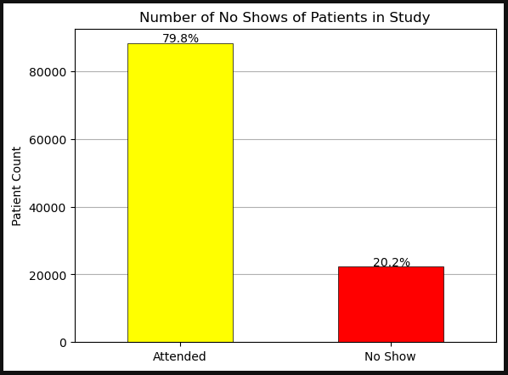
Number of no-shows
In general, about 20% of appointments scheduled with this medical care company for April – June of 2016 in Brazil were not attended.

Slide 5
Questions to answer
Does the time between scheduling an appointment and appointment date impact appointment attendance?
Does the time of day an appointment is scheduled impact attendance?
Does the day of the week have an impact on no-shows?
Does the location of the individual impact no-shows?

Slide 6
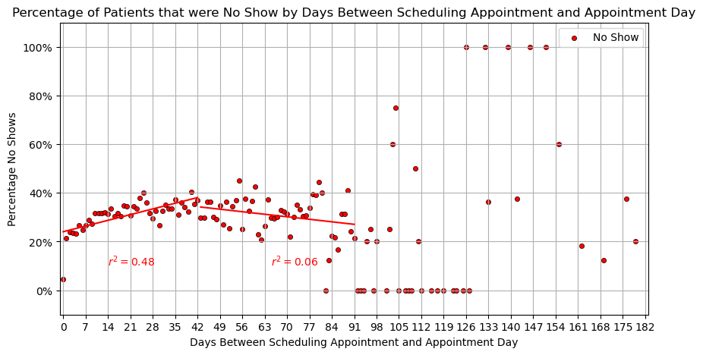
How does time between scheduling and appointment impact attendance?
Same day appointments have a very low rate of no shows.
The rate of no-shows increases as the days between scheduling and appointment increases (up to 42 days), then the rate of no-shows levels out.
There does not appear to be a pattern after 90 days.

Slide 7
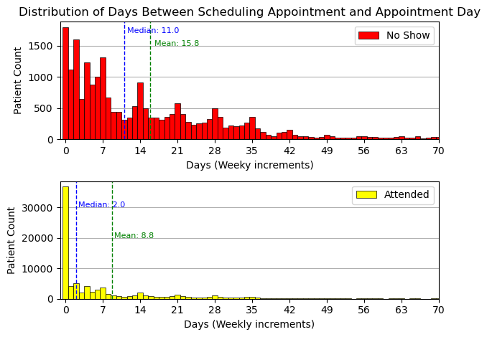
How does time between scheduling and appointment impact attendance?
On average, someone who misses a scheduled appointment scheduled it 15.8 days out.
Someone who attended an appointment they scheduled usually only has a gap of 8.8 days.

Slide 8
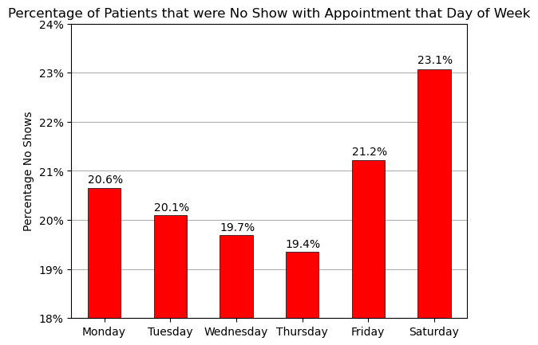
Does the day of the week impact no-shows?
Friday and Saturday have the highest percent of no-shows (yes, Saturday did have some data).
The data shows that appointments on Monday-Thursday had a much higher chance of being attended.

Slide 9
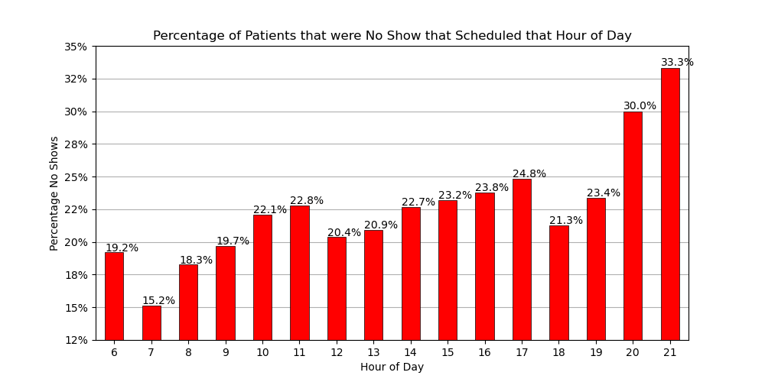
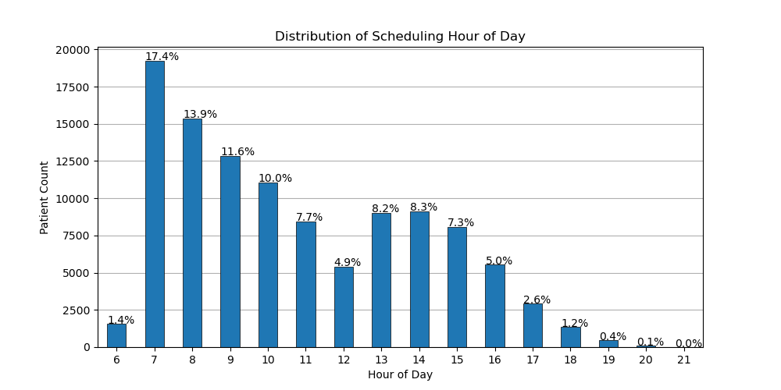
Does the time of day that an appointment is scheduled impact the likelihood of a no-show?
In general, scheduling an appointment earlier in the day was more likely to result in an attended appointment.
People who scheduled between 6am and 9am attended 81.9% of their appointments.
People who scheduled after 7pm attended only 68.3% of the time.

Slide 10
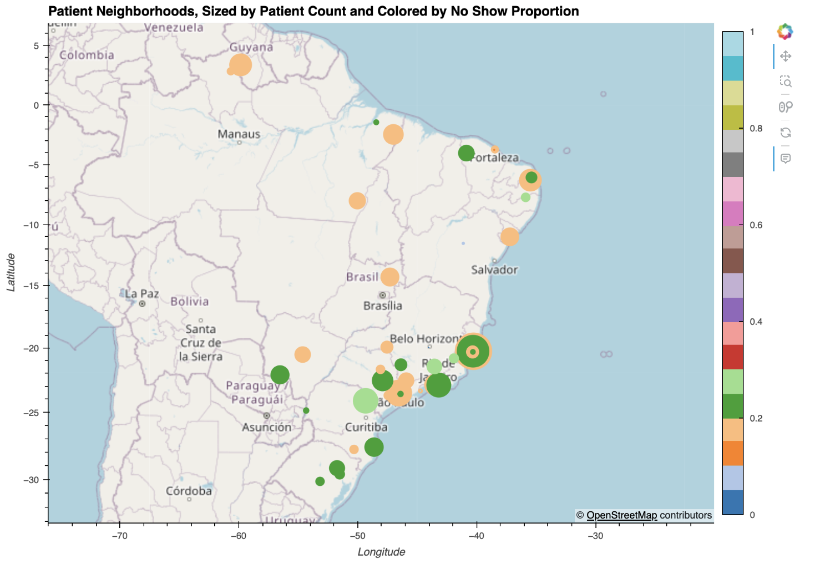
No-shows by location (API*)
Urban areas provided the largest sample size (as expected).
The proportion of no-shows is greater in more concentrated urban areas.

Slide 11
Scheduling Summary
Scheduling appointments closer to the appointment date resulted in a higher chance of attendance.
Scheduling appointments for the middle of the week resulted in a higher chance of attendance.
Morning people are more likely to attend their appointments, especially if the appointment is scheduled before 7pm.
The proportion of no-shows is greater in more concentrated urban areas.

Slide 12
Can technology or outliers impact appointment attendance?
What impact does sending an SMS message have on no-show appointments?
What percent of people opt into receiving text messages?
What does the breakdown of attendance look like when separated by SMS receivers?
What is the average number of appointments someone will have in a 3 month period?
How many appointments can someone have in 91 days?

Slide 13
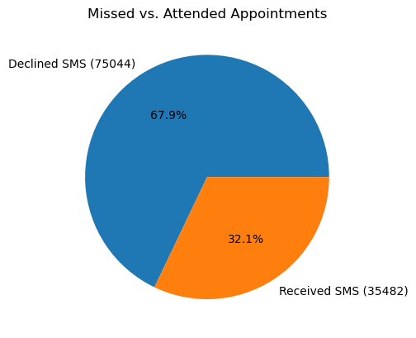
How many people opt in?
Only 32% (35,482 patients) opted in and received text messages during this time. 68% (75,044 people) opted out of text messaging.
The data does not account for people with multiple appointments.

Slide 14
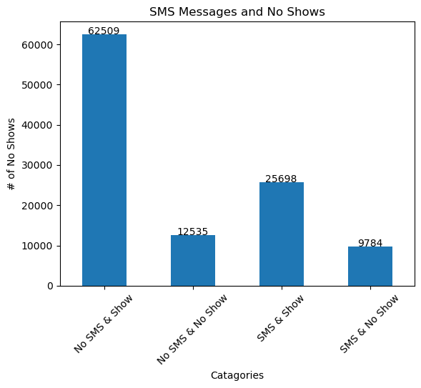
Count of SMS and no show combination
The largest category of people were those who opted out of SMS messaging and still showed up.
Over 9000 appointments were missed even with an SMS reminder.

Slide 15
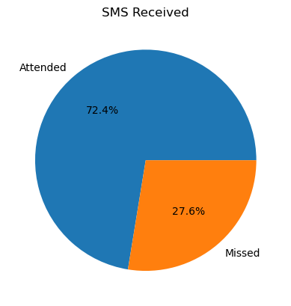
Attendance with an sms received
Almost 30% of people who received a text message still did not attend their appointments.
The 27.6% represents just under 10,000 people.

Slide 16
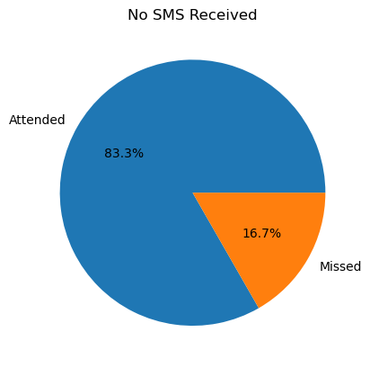
Attendance with no sms received
The total count of people who missed appointments and did not receive an SMS was still over 12,000.
Over 80% of people attended and did not receive a text message.

Slide 17
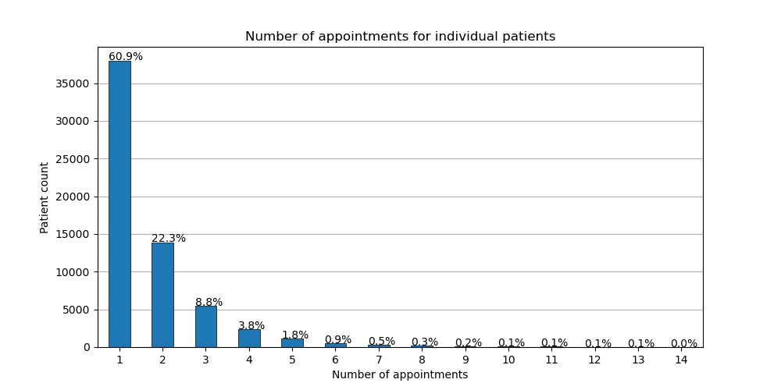
How many patients scheduled multiple appointments?
Over 60% of people attended only one appointment during the months of April – June.
Over 99% of people attended less than 12 appointments in that time.
Outliers in the data reach up to 88 appointments in the 3 month timeframe.

Slide 18
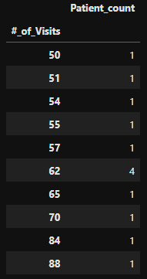
The Outliers
4 patients had 62 visits in 91 days.
2 patients had over 80 visits in 91 days.
13 total patients had 50 or more visits during this time.

Slide 19
SMS and Outlier Summary
People who received an SMS message were 11% more likely to miss their scheduled appointments.
A surprisingly low amount of people opted into the SMS reminder program, so the link between an SMS reminder an appointment attendance does not seem to exist.
The outliers in the data were incredibly small in number, and not likely to impact averages in a meaningful way.

Slide 20
What demographics can impact no-shows?
What impact does age have on attendance?
Are men or women more likely to attend their appointments?
Do patients on Brazil’s Bolsa Família Program attend appointments at a higher rate?
What is the Bolsa Família Program?

Slide 21
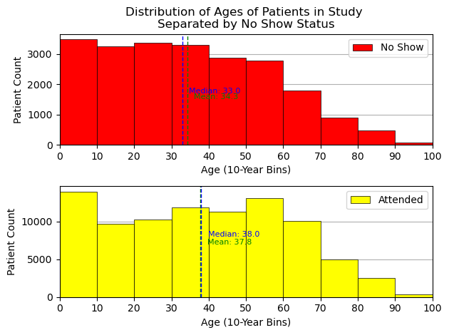
Distribution by age:
The median age of someone who misses an appointment is 5 years younger than people who attend, and the average age is 3.5 years younger.
People between the ages of 10-35 are most likely to miss scheduled appointments.
In general, children and older people are the least likely to miss appointments.
Children under the age of 10 saw the highest volume of appointments.

Slide 22
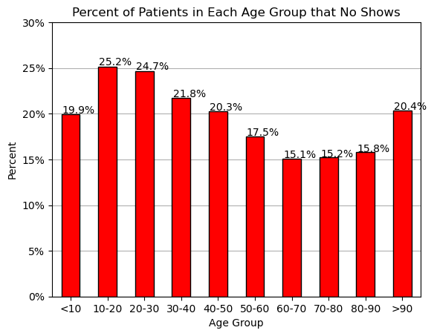
Percent of no shows
Groups with the highest amount of no-shows to appointments range between 10 and 30.
People aged 60-90 were significantly more likely to show up to their appointments.

Slide 23
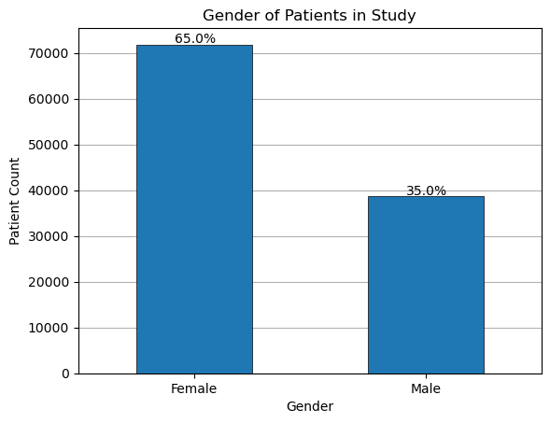
What does the gender breakdown look like?
A majority of the patients who scheduled appointments between April and June of 2016 were female.
71,839 women and 38,687 men had scheduled appointments.

Slide 24
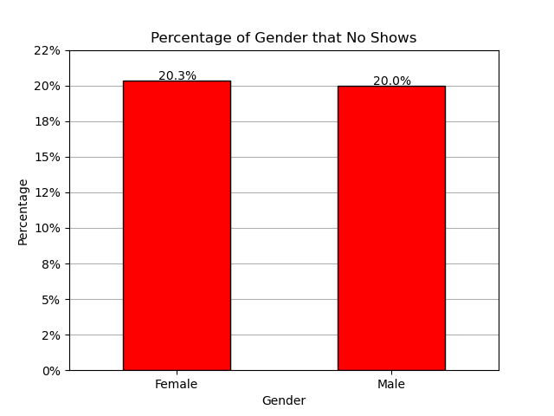
Does gender have an impact on no-shows?
The difference in no-shows between the two genders was negligible.
A total of 14,594 women and 7,725 men missed scheduled appointments during the time available in the data.

Slide 25

What is the Bolsa Família program?
The Bolsa Família program is a Brazilian social welfare program launched in 2003.
Bolsa Família has been credited with significantly reducing poverty rates and improving educational and health outcomes for children in Brazil.

Slide 26
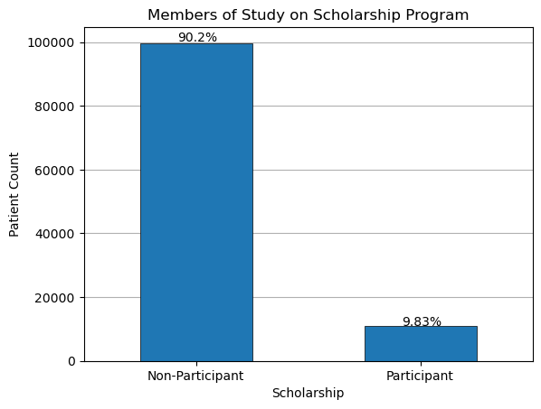
How many people were participants in Bolsa Família?
Roughly 1 in 10 people who had scheduled appointments were participants in the program.
99,665 people were not participants in the program.
10,861 people were participants in the program.

Slide 27
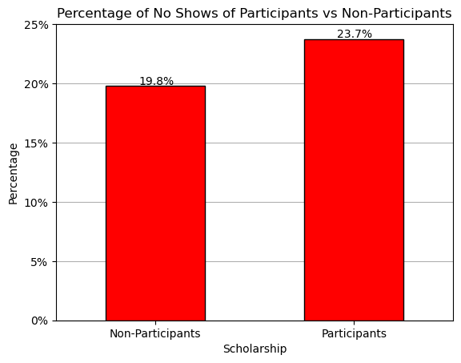
no-shows among people on Bolsa Família vs not on Bolsa Família
Though incentivized to attend, more people who were on Bolsa Família missed appointments than those who were not.
This likely highlights the additional barriers that low income individuals experience when trying to get to an appointment.

Slide 28
Demographics summary
In general, children and older people are the least likely to miss appointments.
Groups with the highest amount of no-shows to appointments range between 10 and 30.
The difference in no-shows between the two genders was negligible.
Participants in the Bolsa Família program were more likely to miss appointments.

Slide 29
how do special conditions impact attendance?
What does the breakdown of patients with special conditions look like?
Are there some conditions that are more prevalent than others?
Does the existence of one condition impact attendance more than others?

Slide 30
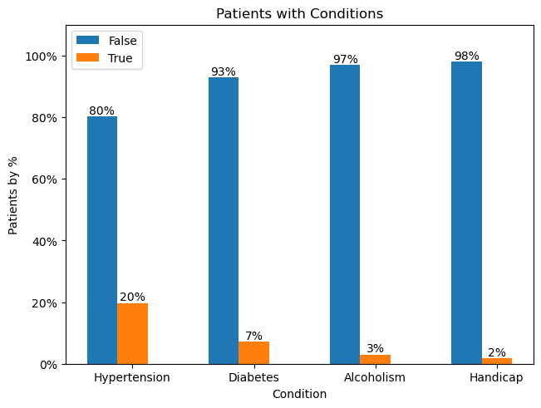
Breakdown of patients with special conditions:
Hypertension impacted a significant amount of patients.
This was about 10x more than people with Handicaps.
Only about 2% of all patients had what the data considered to be a handicap.

Slide 31
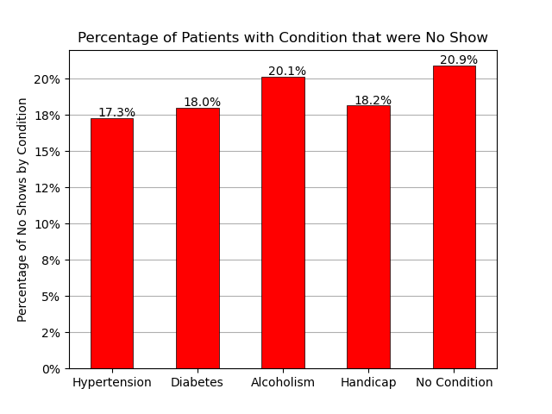
No shows by special condition
People with special conditions showed up more frequently than those who did not have special conditions.
People with Alcoholism showed up at about the same rate as people with no special conditions.
People with Hypertension had the highest chance of showing up.

Slide 32
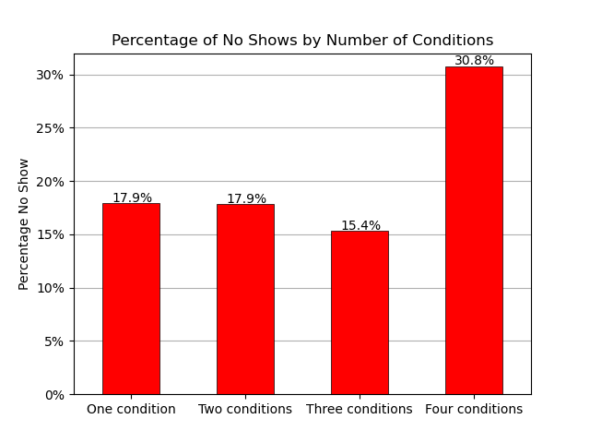
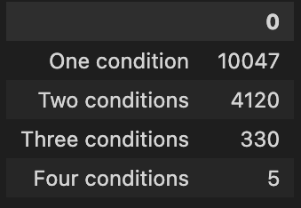
How many patients had multiple special conditions?
Patients with 4 conditions were significantly more likely to miss their appointments than people who had 3 or less special conditions.

Slide 33
Special conditions summary
1 out of 5 people in the data had Hypertension as a special condition.
People who had 4 or more special conditions may have had a harder time getting to their appointments.
People who had a special condition were more likely to show up to their appointments than people who did not have a special condition.
People with Alcoholism had a no-show rate almost equal to people with no special conditions.

Slide 34
What other information would we have liked to have?
Break down missed appointments by clinic.
A larger sample of data, like all of 2016 instead of 3 months.
The appointment time of day:
Do people miss appointments at a specific time of day?
More demographic data:
Income, Access to transportation, employment information, children?, etc.
What types of appointments did people have?
Does the clinic have an impact on missed appointments?

Slide 35
What other questions could we answer with more time?
Checking information from different sections against each other:
Example: What percent of people on Bolsa Família also have a special condition?
Example: Is there a relationship between age and opting into the SMS program?
Multi-linear regression!
Is there something special about the urban areas that made people more likely to miss their appointments?
Further statistical analysis
Hypothesis testing
T-test
Chi Square
Would be interesting to do a further breakdown of no-shows for each type of handicap.

Slide 36

Questions or comments?

